Slide 1
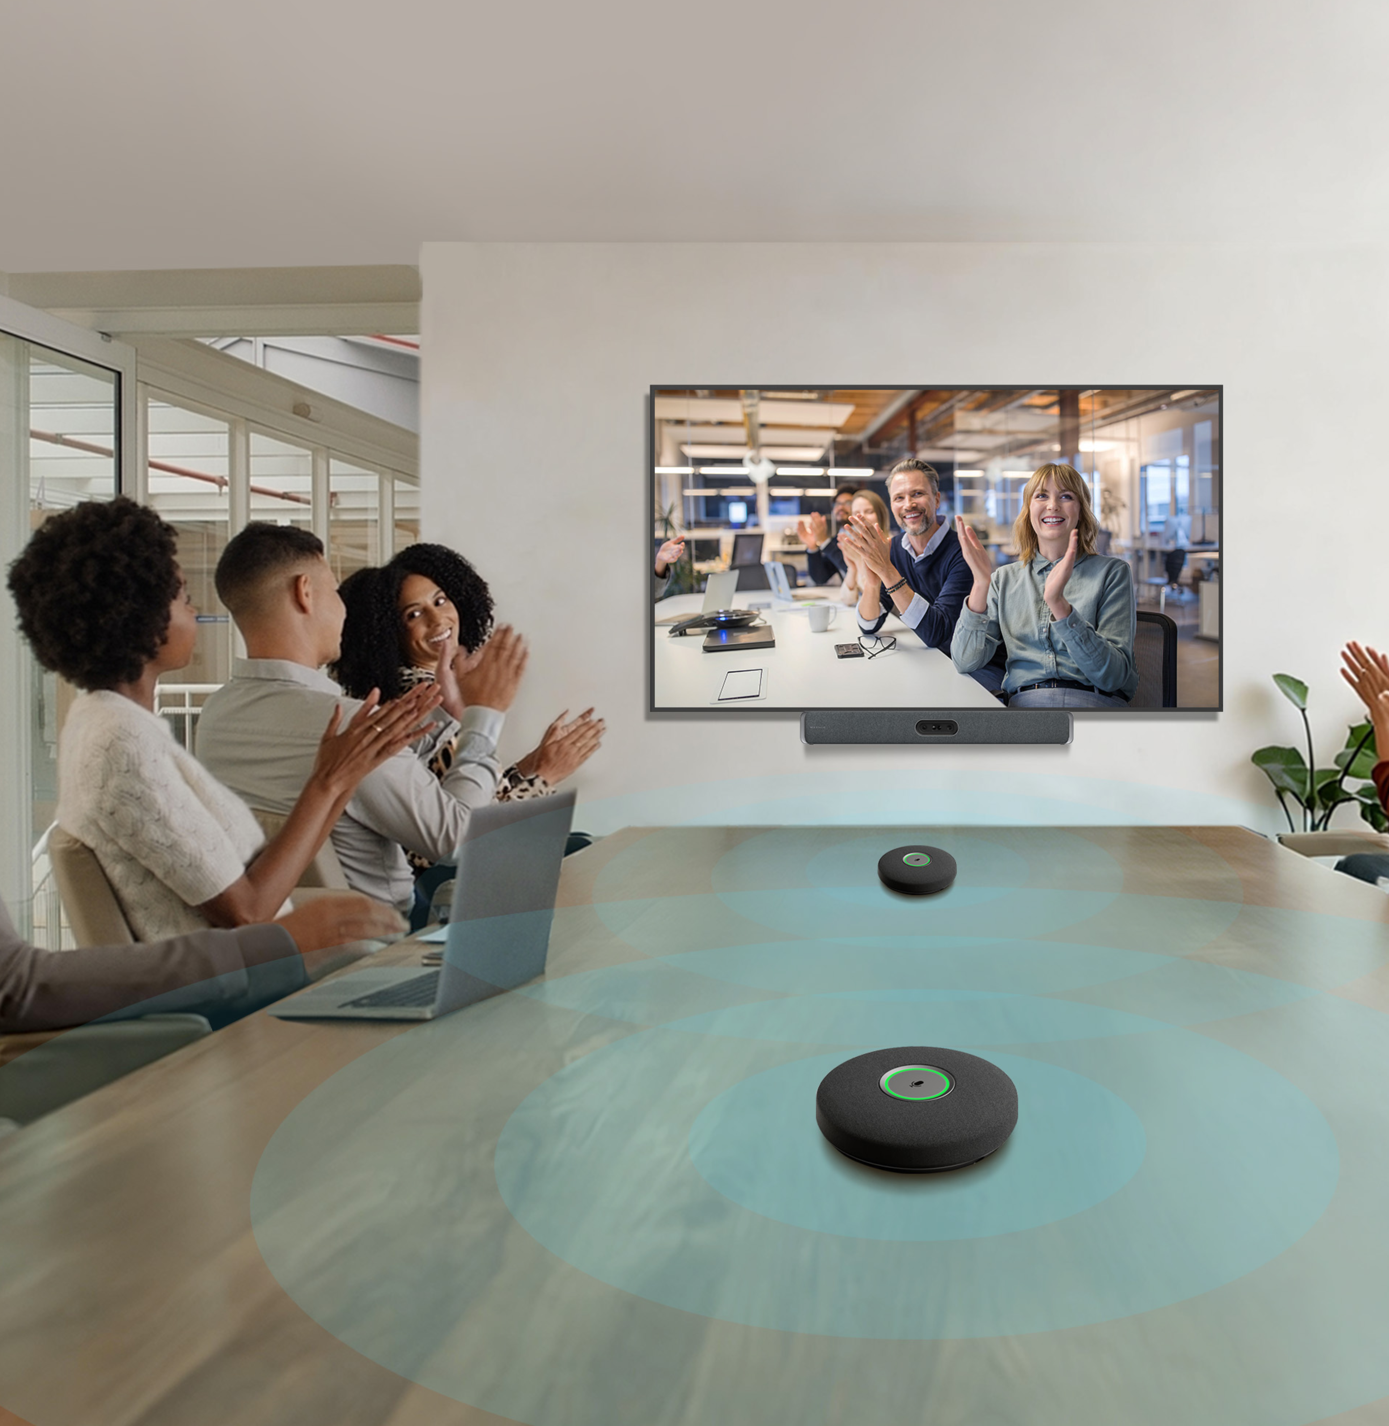
MAXHUB Mic Pod DM30
Date: 2025.12

Slide 2
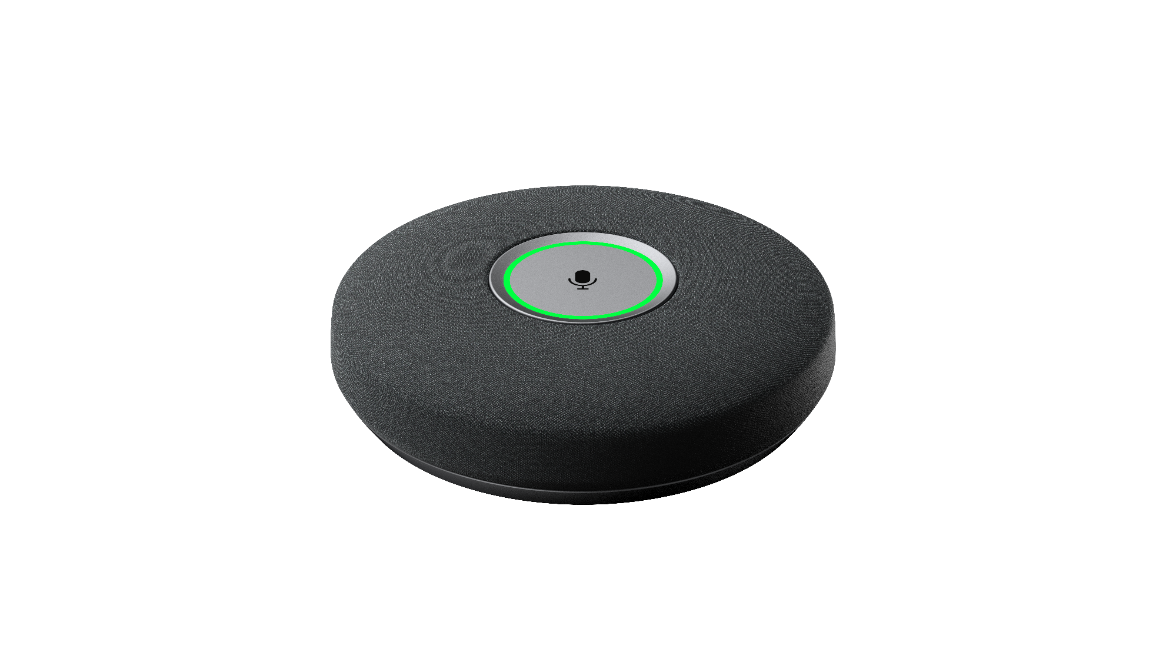
MAXHUB Mic Pod DM30
360° omnidirectional 8 micphone array pickup with support for multi-device cascade expansion.
One-Touch Mute Toggle – A gentle touch instantly toggles the microphone on or off. 
Standard IP-Based Protocol – Enables independent, visual control and management of each device via dedicated management software.
Plug-and-play compatibility with the MAXHUB XBar series.
Integrated AI audio algorithms, including AGC, AEC, and ambient noise reduction. 
Non-slip design with an optional desktop mounting bracket for enhanced stability and positioning.

Slide 3

MAXHUB Mic Pod DM30
The best audio experience for XBar
360°8 mic Array
IP Protocol
Daisy Chain
Plug-and-play
Audio
Algorithm
8-beam Micphone Array
360° Voice Pick-up
pickup range 6m
AGC
AEC
AI nosie reduce
Transmit
Design
Plug-and-play
IP protocol
Daisy Chain
unmute botton
Obvious LED light
Desktop Bracket

Slide 4
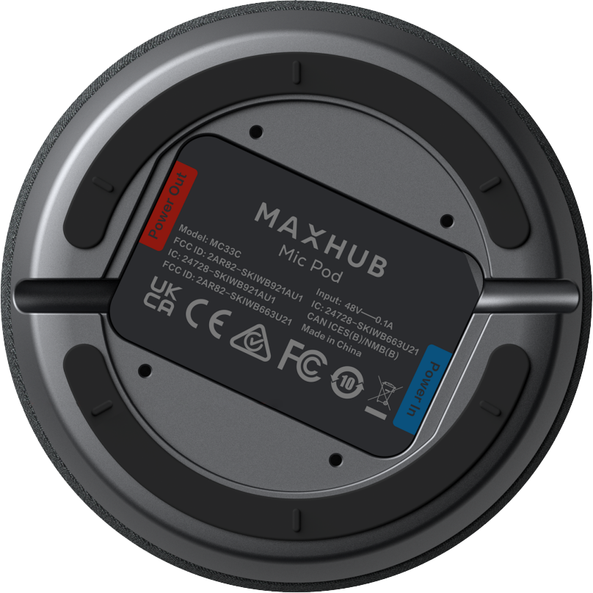
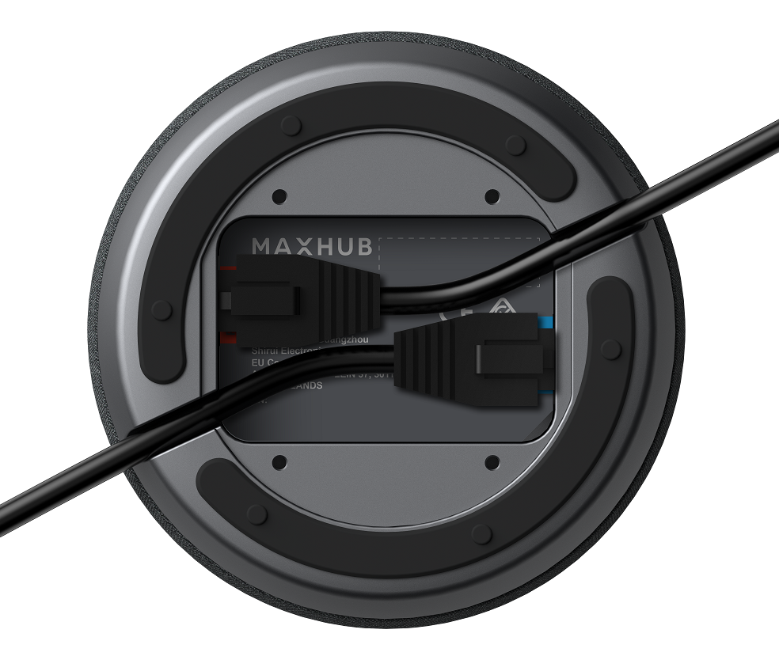
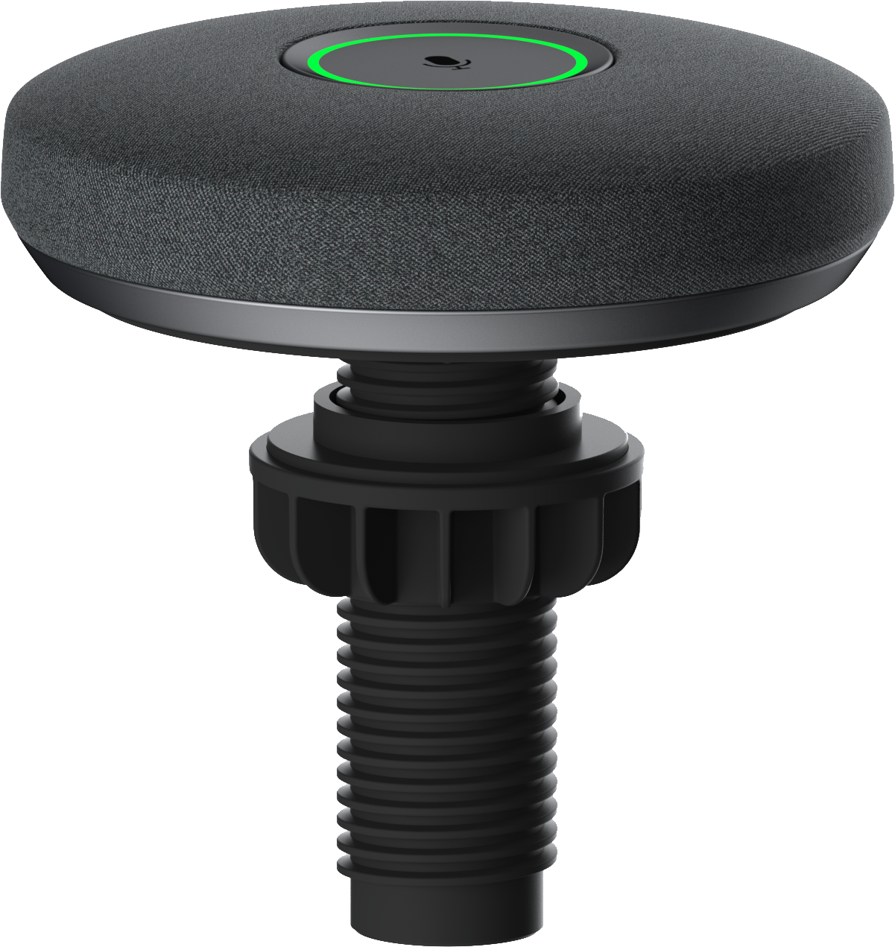
MAXHUB Mic Pod DM30 Sell point
Core Functions Full-scenario audio pickup + HD sound quality, ensuring seamless meeting communication
360° omnidirectional audio pickup + cascading expansion: Omnidirectional audio capture eliminates blind spots across your meeting room, delivering
crystal-clear recordings of both soft individual speech and scattered group discussions. Support for multi-microphone cascading, combined with
plug-and-play operation (no debugging or extra drivers needed), it works seamlessly with XBar to flexibly fit meeting spaces of all sizes and usage scenarios.
AI Audio Algorithm: Integrated with three core AI audio algorithms—AGC (Automatic Gain Control), AEC (Acoustic Echo Cancellation), and environmental noise reduction—the device delivers professional-grade audio processing for meeting scenarios. These algorithms automatically balance the volume of voices from varying distances, eliminate speaker echoes, and suppress over 300 types of background noise (including keyboard typing and air conditioning hum). Even in remote meetings, this ensures crystal-clear, "face-to-face" quality communication.
Ease of Use: Easy to Operate + Seamless Compatibility，Ready to Use Out of the Box
Touch Mute Toggle: Tap the key to turn audio pickup on/off, offering intuitive operation with no mechanical noise. No need to search for physical switches during meetings, and the mute status is clearly visible.
XBar Series Plug and Play: Seamlessly compatible with XBar series products. There is no need for additional driver installation or complex configuration. Simply connect and start using immediately, reducing the cost of device pairing and deployment.
Management and Installation: Flexible Compatibility + Stable Reliability, Meeting Diverse Needs
IP-Centric Visualized Centralized Management: Leveraging standard IP transmission protocols, the software management platform supports independent monitoring of individual or multiple microphones. For enterprise-wide multi-room deployments, IT personnel can remotely oversee the operational status of each device without the need for on-site inspections, thereby substantially enhancing overall operational efficiency.
A Dual Anti-Slip and Locking Structure: This device offers a dual stability solution. For desktop placement, its non-slip base prevents movement caused by vibrations. For permanent installation, it supports a mounting bracket, ideal for scenarios like permanent conference room setups. This design offers both flexibility and stability.

Slide 5
MAXHUB Mic Pod DM30 Sell point
No. | Feature | Advantage | Benefit
1 | 360° Omnidirectional Pickup with Multi-Unit Cascading Support | XBar: Enhanced Pickup, Expanded Coverage, and Flexible Scalability | In mid-to-large conference rooms, the XBar meets full-room audio pickup needs by cascading multiple microphones
2 | Touch-Sensitive Mute Button | Intuitive Operation, Zero Mechanical Noise XBar Status Sync Display | A quick touch toggles mute on/off seamlessly, ensuring zero meeting disruption and broad scenario compatibility.
3 | Standard IP Transmission Protocol Standalone Visual Management Console | Supports batch device monitoring and spot-checking | During multi-room enterprise deployments, IT staff can remotely check individual device status without on-site visits, significantly improving management efficiency
4 | Plug and Play with XBar Series Products | No Extra Drivers, No Complex Setup | Pair with the XBar Series for a conference system that sets up quickly, eliminates compatibility concerns, and reduces costs. Ideal for the rapid deployment needs of small and medium-sized enterprises.
5 | Integrated with AGC, AEC, and AI environmental noise reduction algorithms | Automatically balances volume, eliminates echo, and suppresses noise | Ensures crystal-clear voice communication even during remote collaboration or in noisy environments (like offices with air conditioning or keyboard sounds), delivering an enhanced remote meeting experience.
6 | Features include a non-slip design and support for desk-mount bracket installation | Offers stable placement and adapts to diverse mounting needs | Ensures stable, non-slip placement on desks, and can be securely mounted with a bracket for permanent conference room setups—balancing flexibility with stability

Slide 6


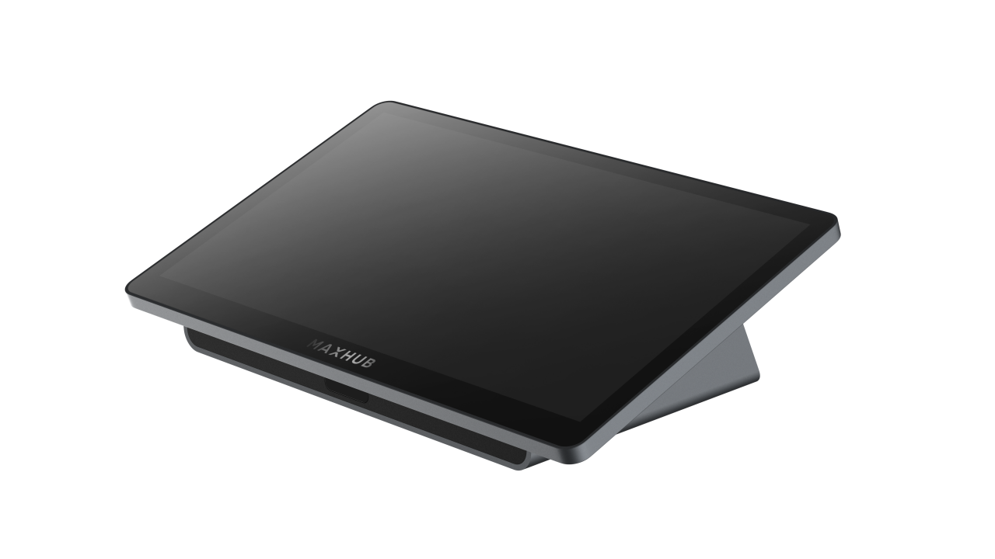
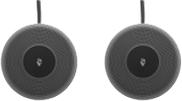

MAXHUB Mic Pod DM30 Applicable Models
MSRP
Focus & Small rooms
Medium
3000+
USD
MS70A
XBar V70 kit
MS75A
XBar W70 kit
1*wide cam（Dual eyes camera system)
2*50MP camera HFOV:120
2*tele cam FOV:40
Andriod 13 MDEP
1*wide cam（Dual eyes camera system)
2*50MP camera HFOV:120
2*tele cam FOV:40
CPU : i5-1340P(13th Gen) Dual display
1500~ 3000
USD
MS55A
XBar V50 kit
1*wide cam（Dual eyes camera system)
2*50MP camera HFOV:120
Andriod 13 MDEP
＜1500
USD
MU55A
XBar U50
1*wide cam（Dual eyes camera system)
2*50MP camera HFOV:120
NO SYSTEM

Slide 7
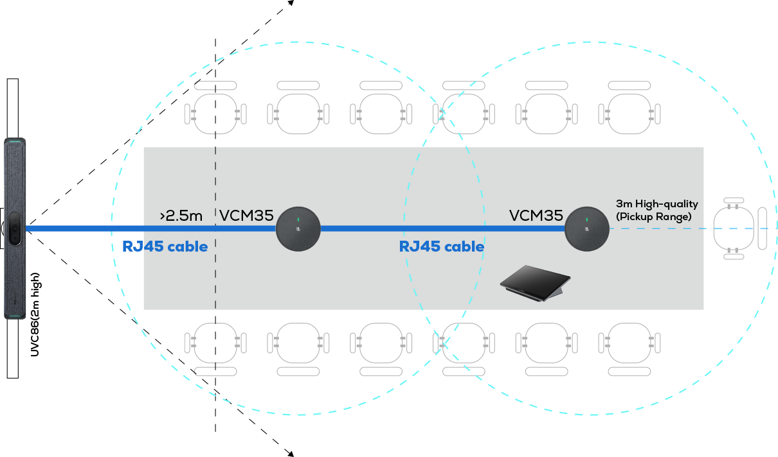
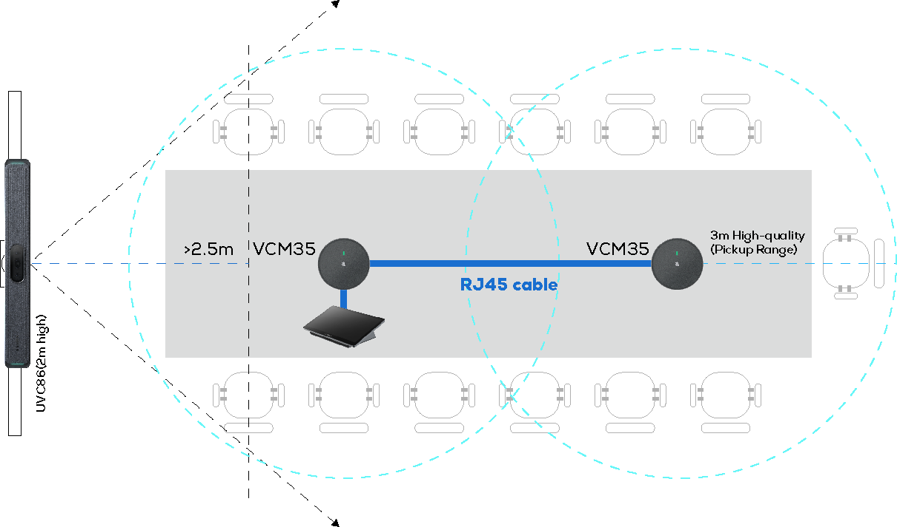
DM30 extension micphone connection way
Connection Ways
Connection for XBar: Connect the Videobar EXT port to the DM30 via RJ45 cables. The Videobar supports power supply by the PoE (Power over Ethernet) protocol.
Connection for Console: Connect the MLINK port of Console AP30 (for V50 & V70 console) to the desktop mic pod via RJ45 cables.

Slide 8
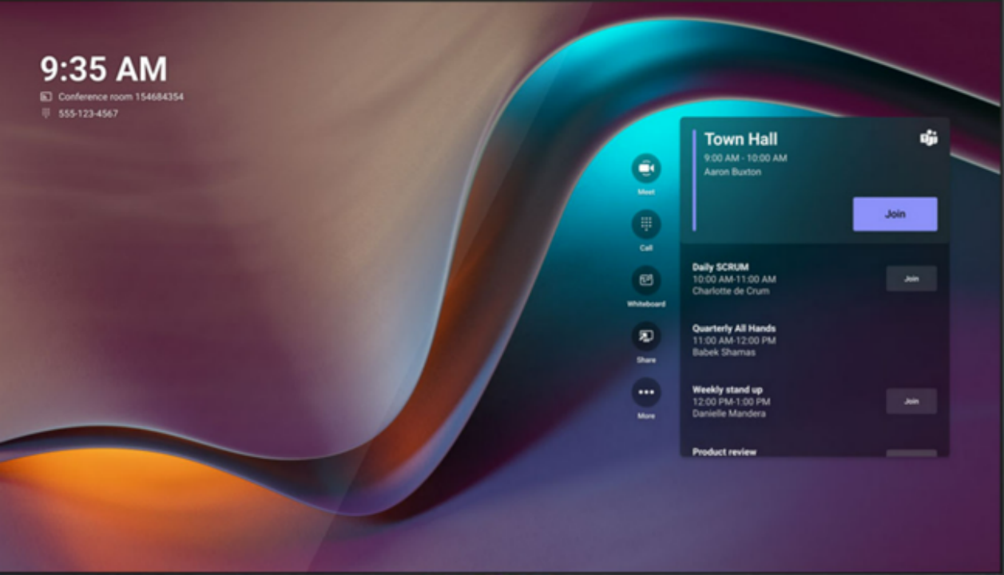

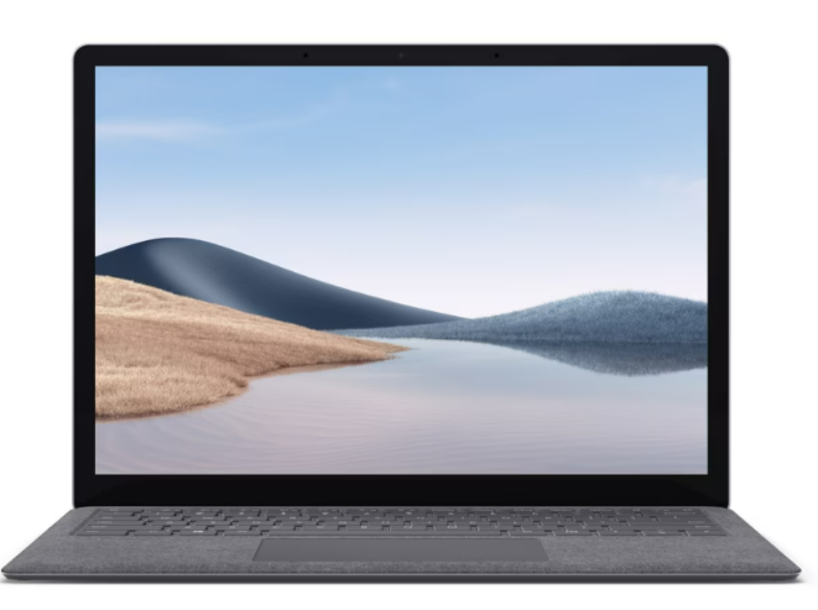
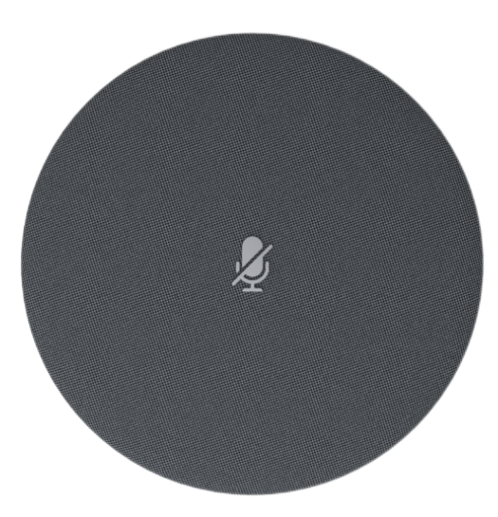
DM30—Teams videobar(Window & Andriod)
videobar (MTR-W)
videobar (MTR-A)
Display support 21:9 and 16:9
Display support 21:9 and 16:9
HDMI
HDMI
HDMI
HDMI
LAN
LAN
RJ45
USB-C
(content share)
RJ45
From Xbar or console
RJ45
USB-C
(content share)
RJ45
console
console
HDMI
RJ45
USB

Slide 9
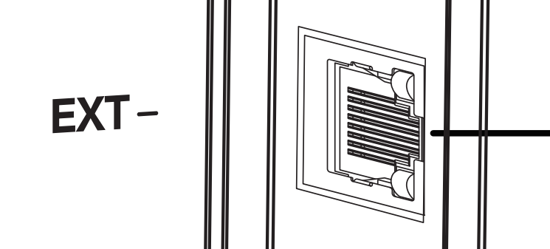
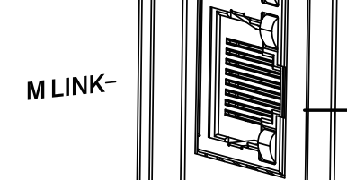
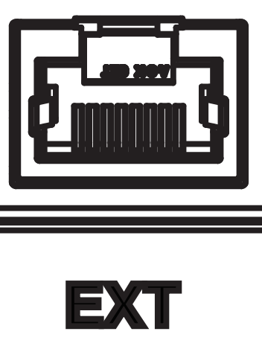
DM30 extension micphone support quantity for XBar
Model | U50 | V50 | V70 | W70
Port
Support Quantity | 2 4（need to supply POE） | 2 4（need to supply POE） | 2 4（need to supply POE） | 2 4（need to supply POE）
Model | NA | AP30 | AP30 | TCP31T
Port
Support Quantity | NA | 2 4（need to supply POE） | 2 4（need to supply POE） | NA

Slide 10
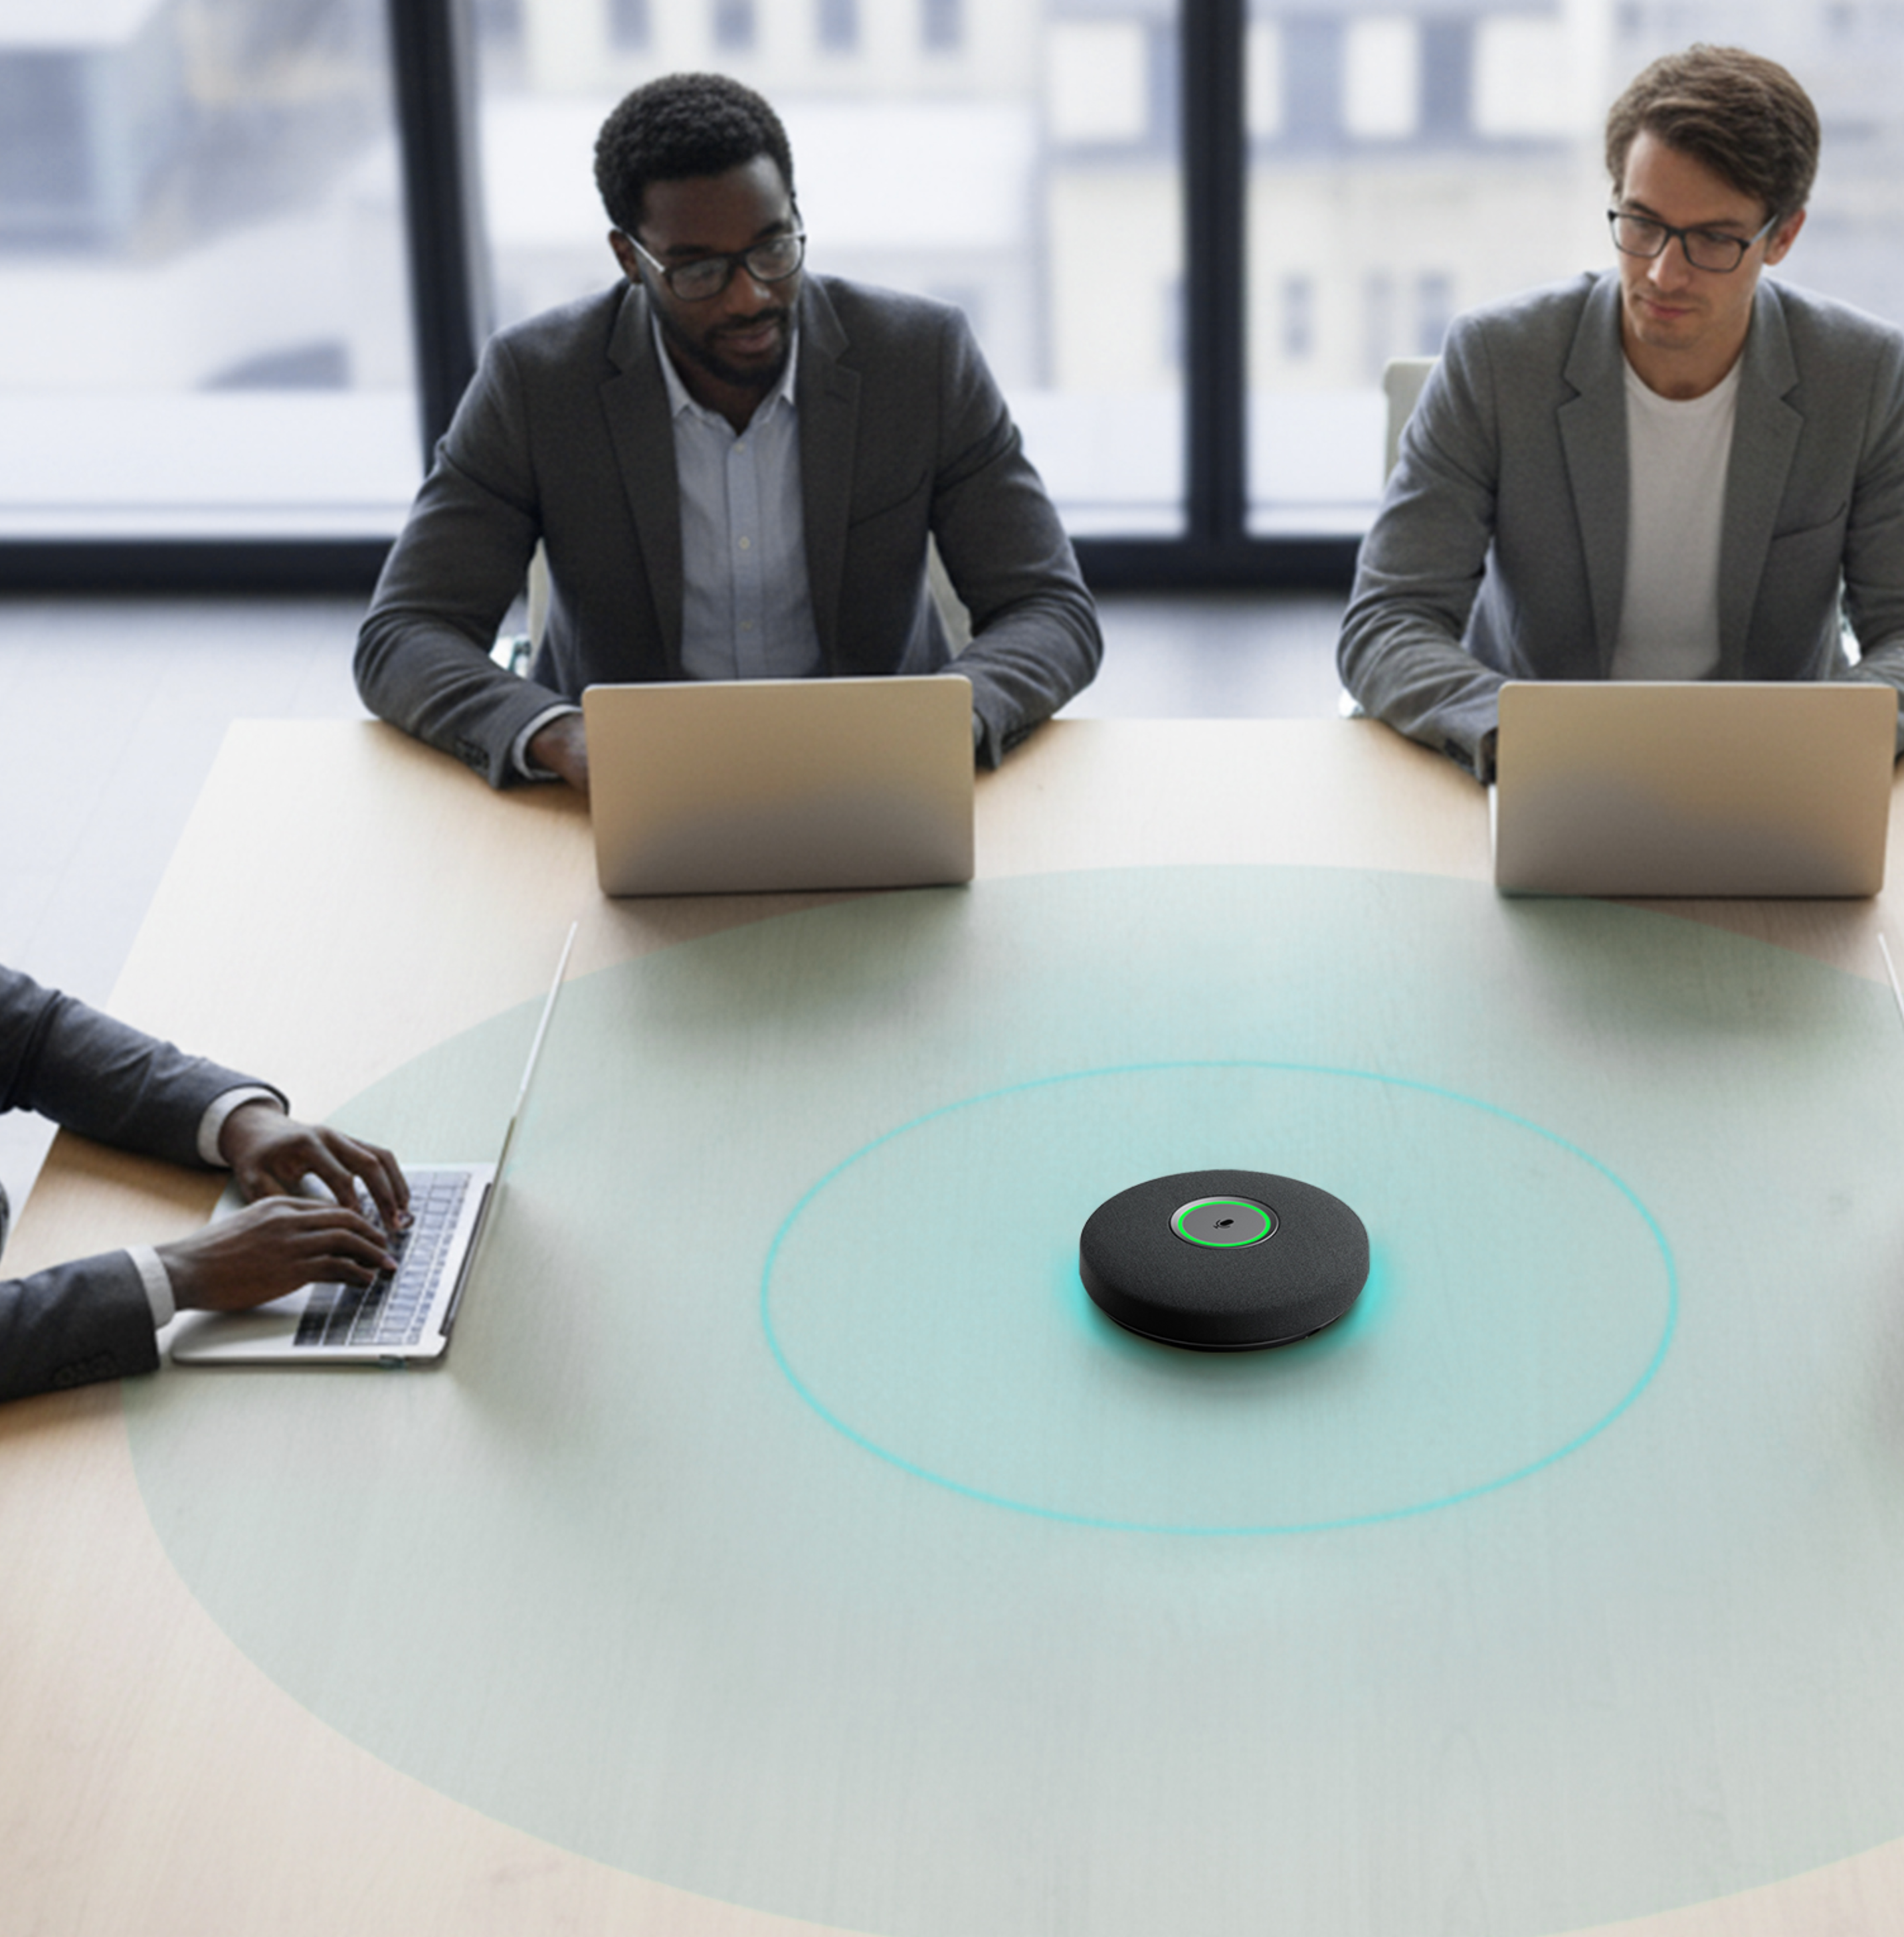
Thanks
www.maxhub.com
sales@maxhub.com
MAXHUB_Global

